Slide 1

InsurAI - Revolutionizing Insurance with AI
InsurAI is an AI-powered insurance advisor. It leverages Agentic AI and LLMs to offer personalized solutions.

Slide 2

InsurAI Overview: Your AI-Powered Insurance Advisor
InsurAI offers personalized insurance advice using AI. It analyzes user needs with Agentic AI and LLMs. Find the best coverage quickly and easily.
Agentic AI
LLMs
Uses autonomous agents to provide personalized insurance advice.
Understands complex user queries with Large Language Models.
Personalized Coverage
Finds the best insurance options based on individual needs.

Slide 3

Key Features: Personalized Assistance & Automation
InsurAI provides personalized assistance and automation. It streamlines the insurance process for users.
1
Personalized Assistance
AI tailors advice to individual user profiles.
2
Claims Automation
Automates the claims process for faster resolution.
3
Fraud Detection
AI identifies and prevents fraudulent claims.
4
Policy Recommendations
Suggests optimal insurance policies based on needs.

Slide 4
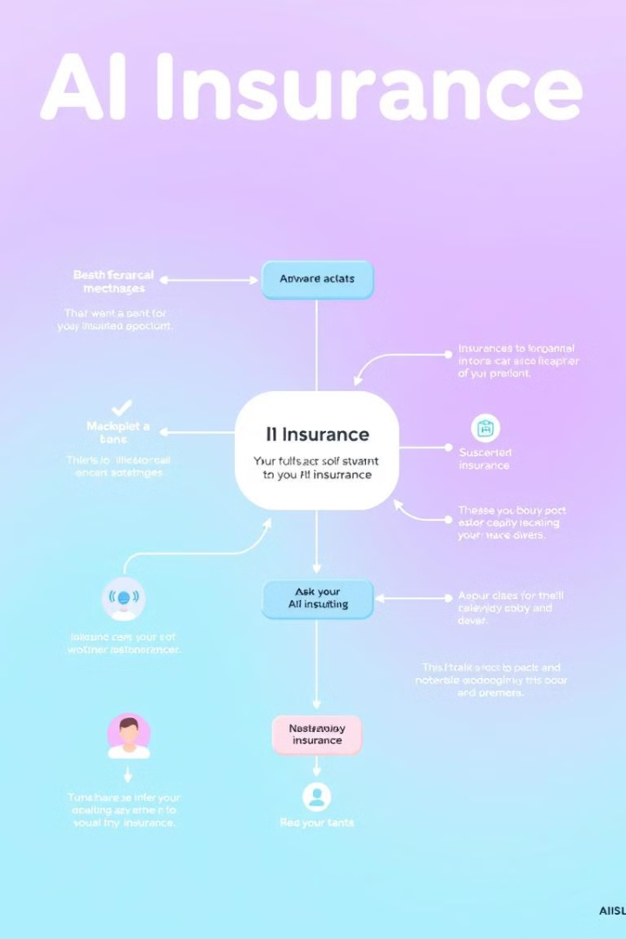




Workflow Diagram: User Interaction to Resolution
See how InsurAI handles user interaction and provides resolution. AI-driven processes ensure a smooth experience.
User Query
User submits insurance-related question.
AI Analysis
AI analyzes query and user data.
Solution
AI provides personalized solution or advice.
Resolution
User gets resolution or policy recommendations.

Slide 5

Claims Automation: A Streamlined Process
Claims are processed smoothly and efficiently using AI. This speeds up resolution and reduces manual effort.
1
Claim Submission
User submits a claim online.
2
AI Verification
AI verifies claim details and documents.
3
Automated Approval
AI approves or flags the claim for review.
4
Payout
User receives payout quickly and securely.

Slide 6




Fraud Detection: AI Vigilance in Action
AI monitors claims for suspicious activity. This helps prevent fraudulent claims and saves money.
Pattern Recognition
Risk Assessment
Flagging System
Assesses the risk level of each claim.
Flags suspicious claims for further review.
Identifies unusual patterns in claims.

Slide 7




Tech Stack: Powering InsurAI
GPT-4, LangChain, FastAPI, and React.js work together to power InsurAI. These tools ensure robust and scalable performance.
GPT-4
1
LangChain
Advanced language model.
2
Framework for LLM applications.
React.js
4
FastAPI
3
Dynamic user interface library.
High-performance web framework.

Slide 8
Benefits: Efficiency, Accuracy, and Savings
InsurAI boosts efficiency and accuracy. It also provides cost savings for both users and insurers.
Efficiency
Accuracy
Savings
Streamlines processes with AI.
Reduces errors in claims processing.
Lowers operational costs and fraud losses.

